Slide 1
Secure Data Hiding in Image Using Steganography
CAPSTONE PROJECT
Student Name: Nayaab Desai
College Name & Department: New LJ Institute of Engineering and Technology

Slide 2
OUTLINE
Problem Statement
Technology used
Wow factor
End users
Result
Conclusion
Git-hub Link
Future scope

Slide 3
Problem Statement
In an era of growing digital threats, protecting confidential information is crucial. This project implements image steganography, allowing users to hide secret messages within images securely. The system ensures message encryption and retrieval using a password-protected approach. With a simple and interactive GUI, users can easily select images, encode messages, and decode them when needed, enhancing both security and usability.

Slide 4
Technology used
Programming Language: Python
Libraries:
OpenCV – For image processing and manipulation
Tkinter – For creating the graphical user interface (GUI)
OS – For handling file operations
String – For character mapping and encryption logic
Platform: Works on Windows

Slide 5
Wow factors
Enhanced Security – A password-protected encryption system ensures only the right user can
decrypt the hidden message.
Simple & Intuitive Interface – A user-friendly GUI built with Tkinter makes the process seamless,
even for beginners.
Works Across Platforms – Compatible with Windows, Linux, and macOS with minimal setup
adjustments.
Fast & Lightweight – Utilizes OpenCV for efficient pixel-based encryption without slowing down
he system.
Customizable Image Selection – Users can choose any image for embedding messages,
adding personalization.
Invisible Alterations – The message is embedded with minimal pixel modifications, making it
undetectable to the naked eye.

Slide 6
End users
Military & Defense Personnel – Useful for securely transmitting classified or sensitive information.
Cybersecurity Learners – Those exploring data hiding techniques and encryption methods.
Journalists & Activists – Individuals needing discreet ways to share confidential information.
Privacy-Focused Users – People who want to protect personal messages from prying eyes.
Students & Educators – Ideal for demonstrating steganography concepts in academic settings.
Security Professionals – Can be leveraged for secure communication in the forensic field.

Slide 7
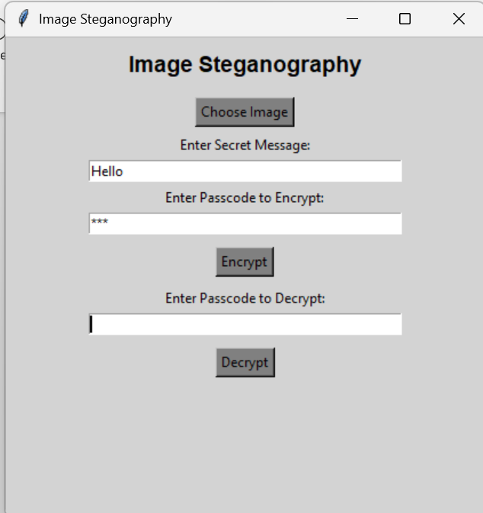
Results

Slide 8
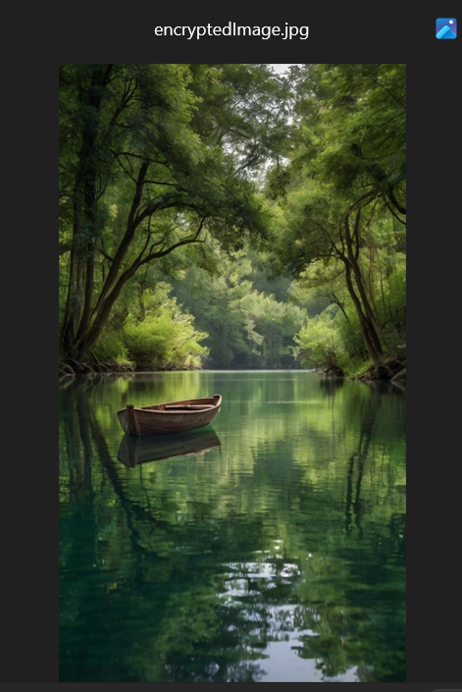
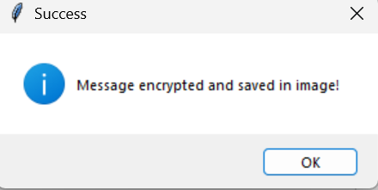

Slide 9
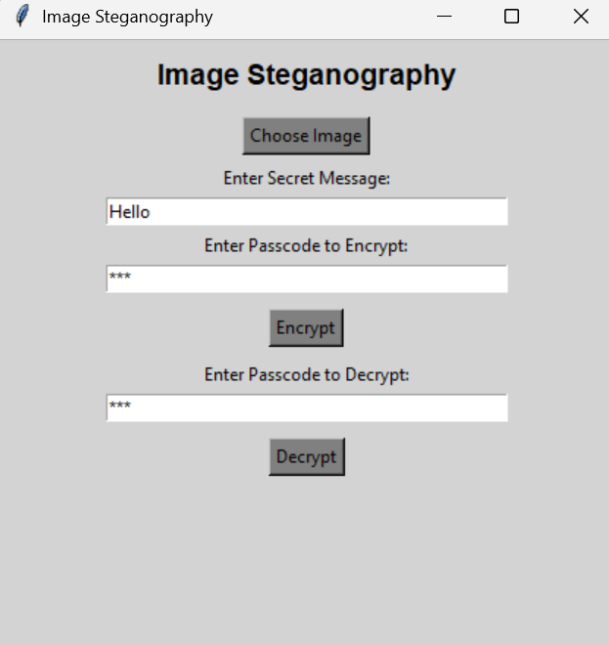
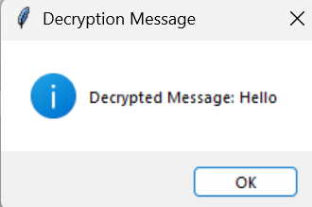

Slide 10
Conclusion
This Image Steganography project provides a secure way to conceal messages within images, ensuring
confidential communication. Utilizing OpenCV and Tkinter, it offers a user-friendly interface while maintaining
strong data protection. Its password-protected encryption makes it valuable for military personnel, journalists,
and individuals prioritising privacy. With cross-platform support, the project highlights the effectiveness of
steganography in safeguarding sensitive information.

Slide 11
GitHub Link
https://github.com/NayaabDesai/IBM-skillsbuild-internship-project-Steganography-

Slide 12
Future scope
Stronger Security Measures – Incorporating advanced encryption techniques to boost data protection.
Broader File Compatibility – Extending the method to conceal messages in audio, video, and document files.
Higher Storage Efficiency – Improving algorithms to embed larger messages while preserving image quality.
AI-Powered Concealment – Using artificial intelligence to make hidden data undetectable by forensic tools.
Cloud-Based Accessibility – Enabling secure cloud storage and encrypted image sharing.
Cross-Platform Mobile App – Developing a mobile-friendly version for easy and secure communication.

Slide 13
THANK YOU

